Slide 1
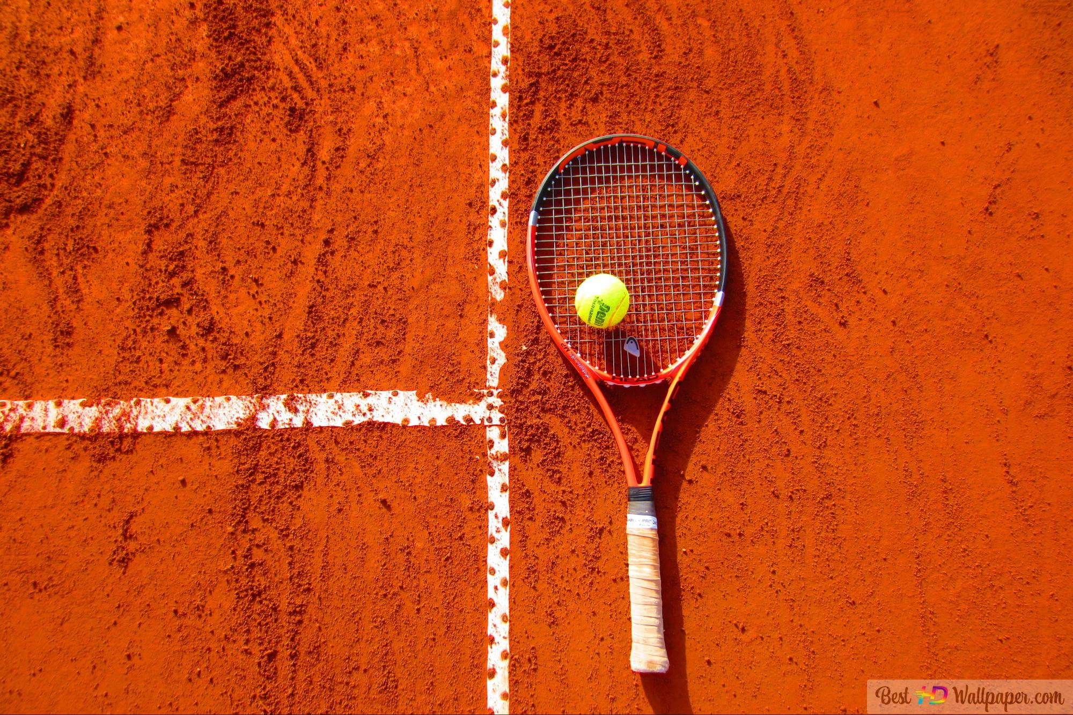
TENNIS MATCH WINNING PLAYER PREDICTION
Sivananda Reddy Bushireddy
Narender Reddy Konuganti
Shrawani Misra
Sudeshna Sarkar

Slide 2
PROBLEM STATEMENT
The goal of the project is to explore data from ATP tennis competitions in order to predict the results of tennis matches.
Notes:
Defining the Project’s purpose:

Slide 3
Project Flow
1
3
Data Cleaning
Data Validation
Visualization
Data partition
Evaluation
Recommendations
Future Work
Data Source
Modeling
Data Preparation
Interpreting the Results
Data Sources
Platform
Dataset Description
Technique/solution
Inputs/output
2
4
Notes:
Here is the project flow we used. We will review the data source and prepare data, then modeling and interpreting the resutls

Slide 4
Project Flow
1
3
Data Cleaning
Data Validation
Visualization
Data partition
Evaluation
Recommendations
Future Work
Data Source
Modeling
Data Preparation
Interpreting The Results
Data Sources
Platform
Dataset Description
Technique/solution
Inputs/output
2
4
Notes:
First let’s review the dataset

Slide 5
Data source
Dataset is taken from Kaggle: https://www.kaggle.com/code/ahlemj/predict-atp-tennis/data
The dataset contains results for the men's ATP matches played since 1968 and this dataset contains 14 features(after cleaning) that can be used to predict the results of tennis matches.
Platform
We have used Azure Databricks Notebook (PySpark)

Slide 6
Dataset description
Field name | Description | Field name | Description
winner_age | Winning player age | loser_age | Losing player age
winner_hand | Winning player hand | loser_hand | Losing player hand
winner_ht | Winning player height | loser_ht | Losing player height
winner_id | Winning player id | loser_id | Losing player id
winner_ioc | Winning player ioc | loser_ioc | Losing player ioc
winner_rank | Winning player Rank | loser_rank | Losing player rank
winner_rank_points | Winning player rank points | loser_rank_points | Losing player rank points
Tennis ATP dataset
14 data fields

Slide 7
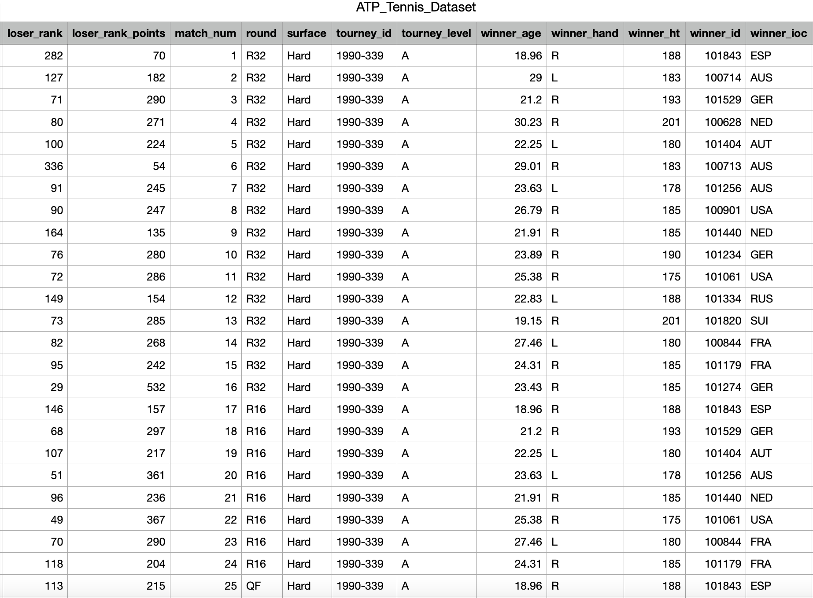
Dataset View

Slide 8
Project Flow
1
3
Data Cleaning
Data Validation
Visualization
Data partition
Evaluation
Recommendations
Future Work
Data Source
Modeling
Data Preparation
Interpreting The Results
Data Sources
Dataset Description
Technique/solution
Inputs/output
2
4
Notes:
Next let’s look at data Preparation

Slide 9
Analyzing and Exploring Data
Data understanding such like its information, description, uniqueness
Dropping the unnecessary features
Missing value treatment
Adding new column(s)

Slide 10
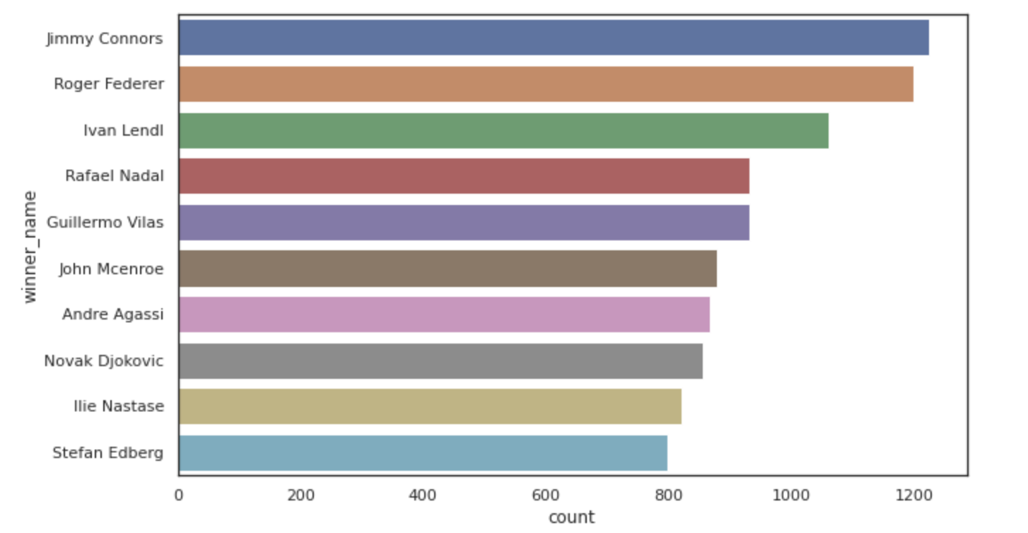
Visualizing The Data
Bar Graph
Representation of Target

Slide 11
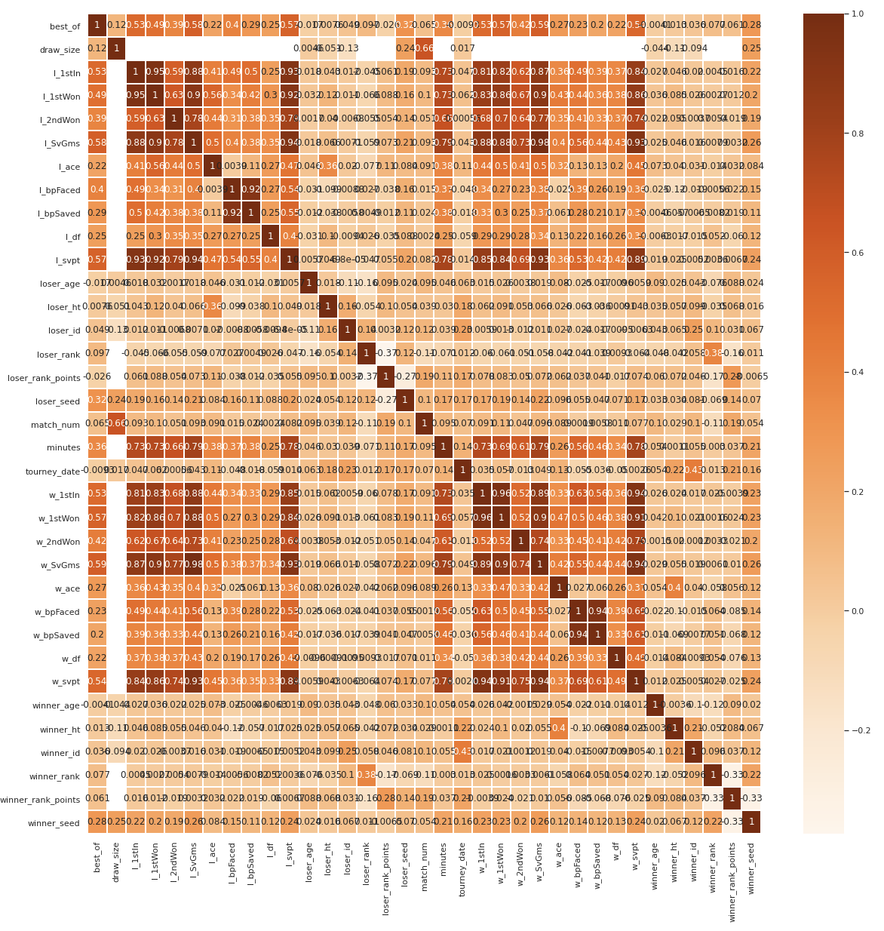
Correlation Matrix
Target variable
Predictors
Models

Slide 12
Project Flow
1
3
Data Cleaning
Data Validation
Visualization
Data partition
Evaluation
Recommendations
Future Work
Data Source
Modeling
Data Preparation
Interpreting The Results
Data Sources
Dataset Description
Technique/solution
Inputs/output
2
4
Notes:
Third, let’s model our dateset

Slide 13
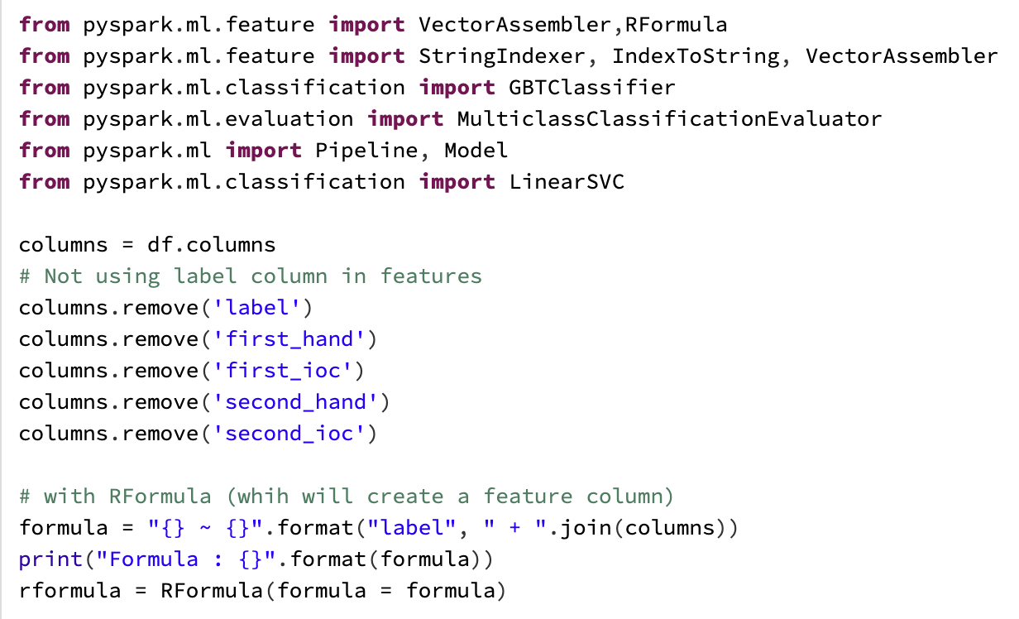
Model Algorithms
Rformula

Slide 14
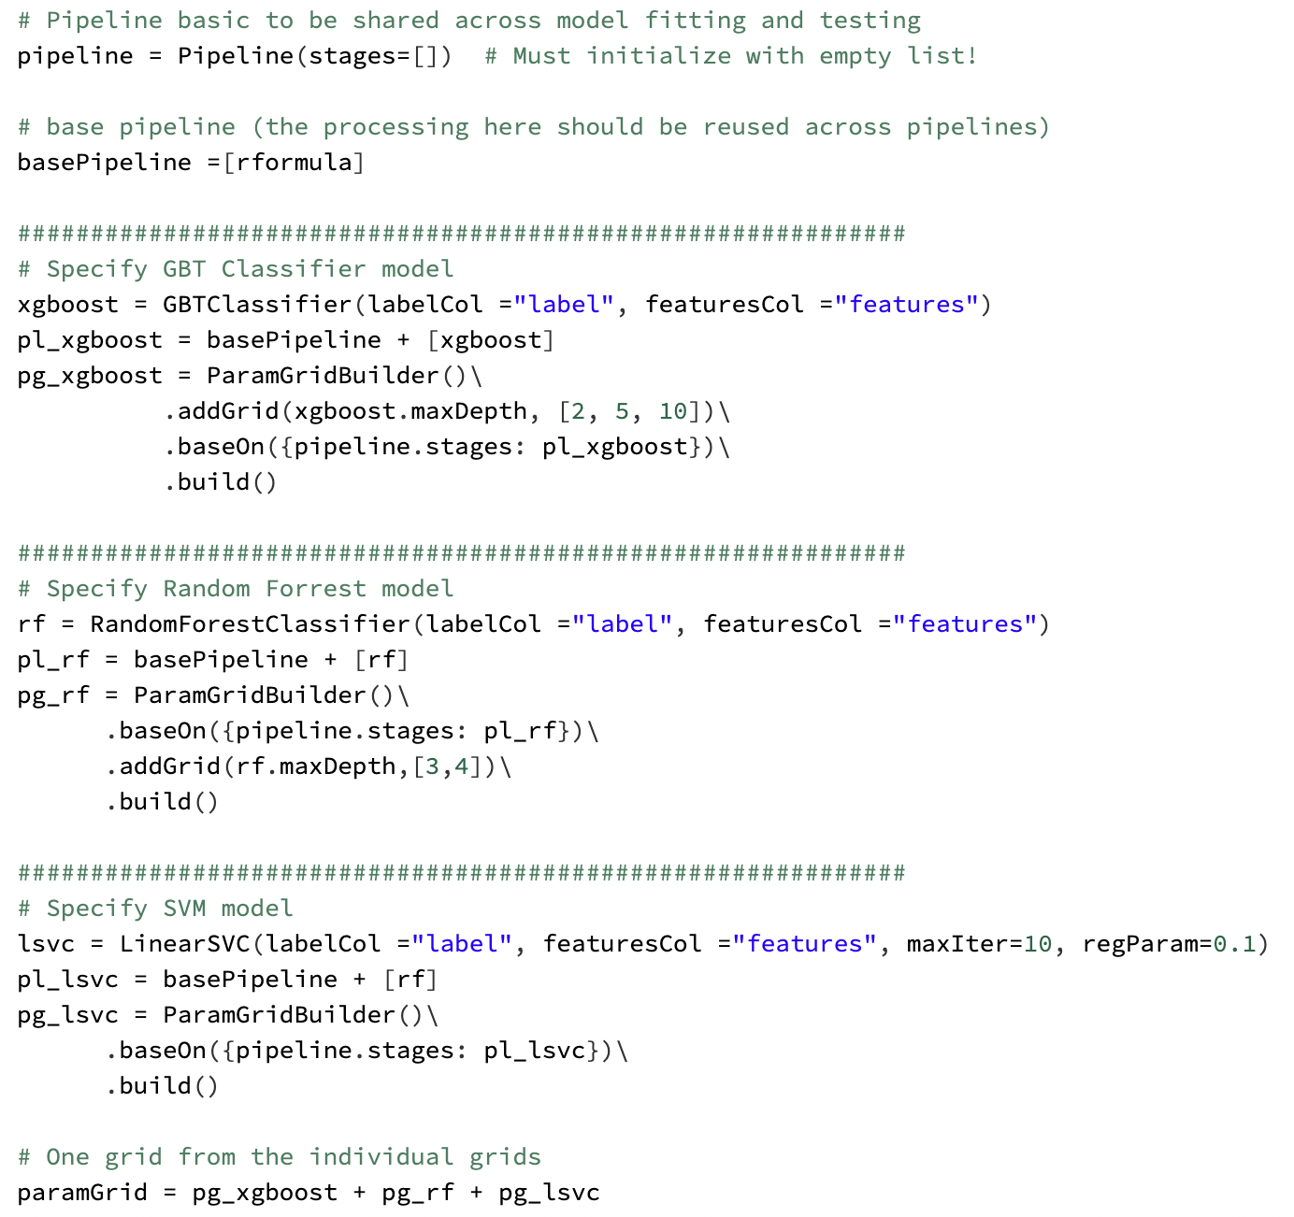
Model Algorithms
Creating pipeline
GBT classifier Model
Classification ML Models
Random Forest Model
SVM Model

Slide 15
Project Flow
1
3
Data Cleaning
Data Validation
Visualization
Data partition
Evaluation Result
Recommendations
Future Work
Data Source
Modeling
Data Preparation
Interpreting the Results
Data Sources
Dataset Description
Technique/solution
Inputs/output
2
4
Notes:
Last, we will do out conclusion

Slide 16
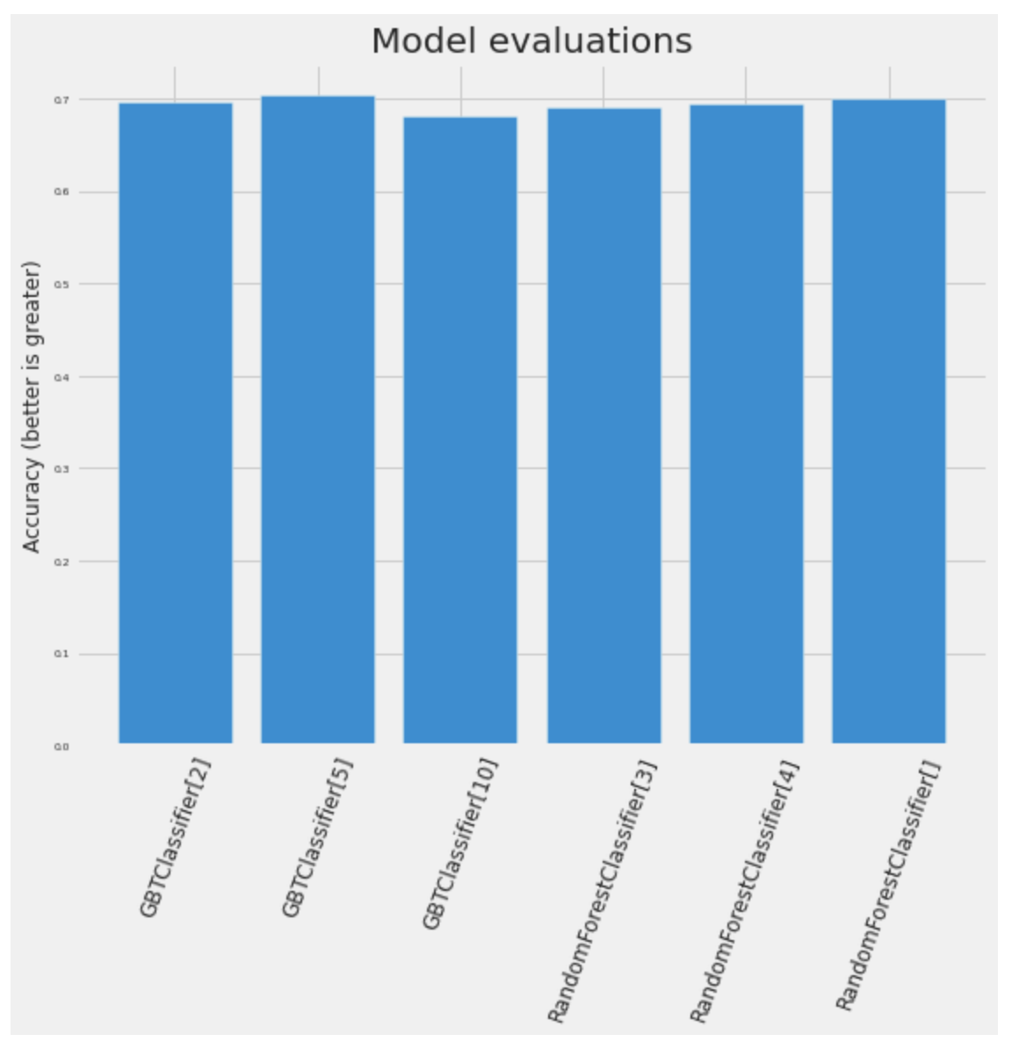
Evaluate the best model
GBT Classifier(maxDepth=5) is the best model with accuracy ~70%

Slide 17
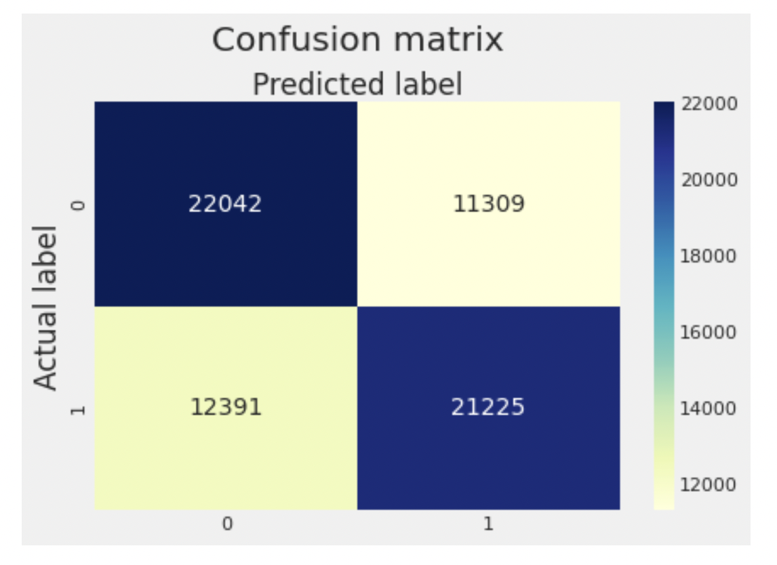
Confusion Matrix of the best model

Slide 18
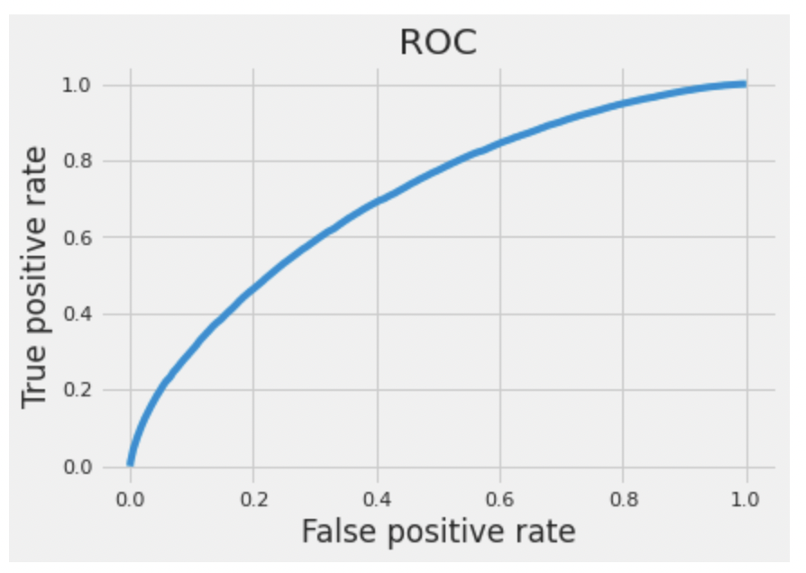
ROC Curve

Slide 19
The outcomes of this model are useful for sports enthusiasts to see the odds of a player when supporting
For profits, it is useful from the point of making merchandises in advance for players that have more odds of winning that will be popular with the crowds in the future.
Finding
.
For betting odds, this model can give a high accuracy for placing bets on a probable winner.

Slide 20
Future Work
Collecting the latest data and implementing GBT model to find the efficiency of the model.
Technically, we would be exploring more models and applying some more methods for better accuracy like neural networks.
We would also like to deploy this model on websites with Visualization tool and would also incorporate user input to directly get tennis player winner prediction.

Slide 21
Q&A

Slide 22
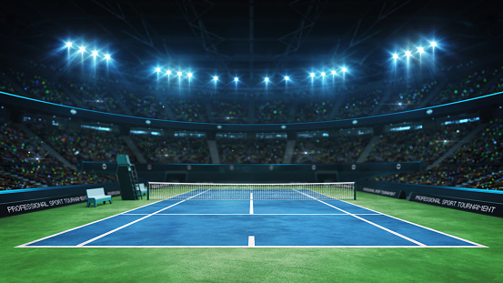
THANK YOU

